Slide 1

Modeling and Simulation of Multi-Level Power Converters for Wind Turbine Systems using MATLAB-Simulink
Shubhan Mital | 2019B4A30900H
Divye Kalra | 2019B4A31291H
Diya Thomas | 2019B1A31096H
Hitesh Kumar | 2019B2A31548H
Tanvi Behera | 2019B5A80989H
Aryabhatta Dey | 2019B5A80819H
FACULTY: Dr. Sudha Radhika

Slide 2

Outline of our Paper
Abstract
Introduction
Methodology
Neutral Point Clamped (NPC)
Modular Multilevel Converters (MMC)
Simulation
Results
Conclusion
References

Slide 3
Abstract
Diversifying energy supply towards renewable sources like wind, hydropower, and solar energy is necessary to reduce dependence on fossil fuels.
Wind farms are growing worldwide, and modern grid systems are making wind energy systems more impactful in the current energy market.
Renewable energy capacity in India has doubled in the past eight years, with the fourth-largest installed wind power capacity globally at nearly 42 GW.

Slide 4
Abstract
Main Content in bullets
Power electronic converters are used to synchronize wind turbines with the grid, converting variable frequency output to fixed frequency suitable for the grid.
The research aims to simulate various power converter models, analyzing parameters like turbine frequency and output voltage to determine efficiency and economic sustainability.
The power converter models being analyzed include three-level neutral point clamped and modular multilevel converters.

Slide 5
Why Boost Converter isn't enough?
Boost Converters has only one output voltage which might not be enough for high-power applications like in Wind Turbines.
Boost Converters employs only a single switch which makes it less efficient than NPC.
Boost Converters can produce high EMI and noise due to fast switching which can be problematic if the converter is located near sensitive electronics.
Because of the following reasons we looked into NPC and MMC Converters.

Slide 6
Introduction
Neutral Point Clamped:
NPC is a multilevel power electronics topology used to convert DC to AC or AC to AC.
It is named for the clamping of the neutral point of the three-phase AC output to the DC input voltage.
The NPC topology uses capacitors and switches to create multiple voltage levels.
The NPC converter has lower switching losses and higher efficiency than traditional two-level converters.
The NPC topology is widely used in high-power applications like wind turbines, solar inverters, and electric vehicles.

Slide 7
Introduction
Modular Multilevel Controllers:
The Modular Multilevel Converter (MMC) is a type of voltage converter used in power supply networks to generate a multistep voltage waveform.
MMCs are state-of-the-art and industry relevant due to their ability of bidirectional power conversion.
The term 'modular' is attributed to the physical substructures of MMCs.
The industry has an interest in increasing the efficiency and usage convenience of various converter topologies.

Slide 8
Methodology
The improved wind turbine system specifications are given with reference to subsystems/devices used.
Input parameters chosen for the wind turbine system are pitch angle, wind speed and generator speed.
The output of the system (mechanical torque) is then fed to permanent magnet synchronous machine.
The AC output is then fed to a thyristor rectifier that converts the AC voltage to a DC parameter.
NPC / MMC is utilized as an inverter

Slide 9
Methodology
After the inversion action, a fully controlled thyristor is used to convert the AC-natured output to DC.
Capacitors are connected in parallel to increase the electrical energy stored and reduce rippling (filtering action).
A boost converter is used to increase the voltage level of the generator output to the required grid voltage level.
The duty cycle of the switch in the converter determines the output voltage level of the converter.
The duty cycle is controlled by a PWM signal, which adjusts the on-time and off-time of the switch.

Slide 10
Methodology - NPC
NPC converters use capacitors and switching devices to create multiple voltage levels from a DC input.
The NPC converter has three phases, each with an upper and a lower switch and a midpoint neutral point.
The neutral point is clamped to the input voltage through a series of capacitors, which results in a stepped waveform that approximates a sine wave.
The capacitors store and discharge energy during the switching cycle to maintain the voltage levels and minimize voltage ripple.
The output voltage can be controlled by varying the modulation index of the pulse width modulation (PWM) signal that controls the switching devices.

Slide 11
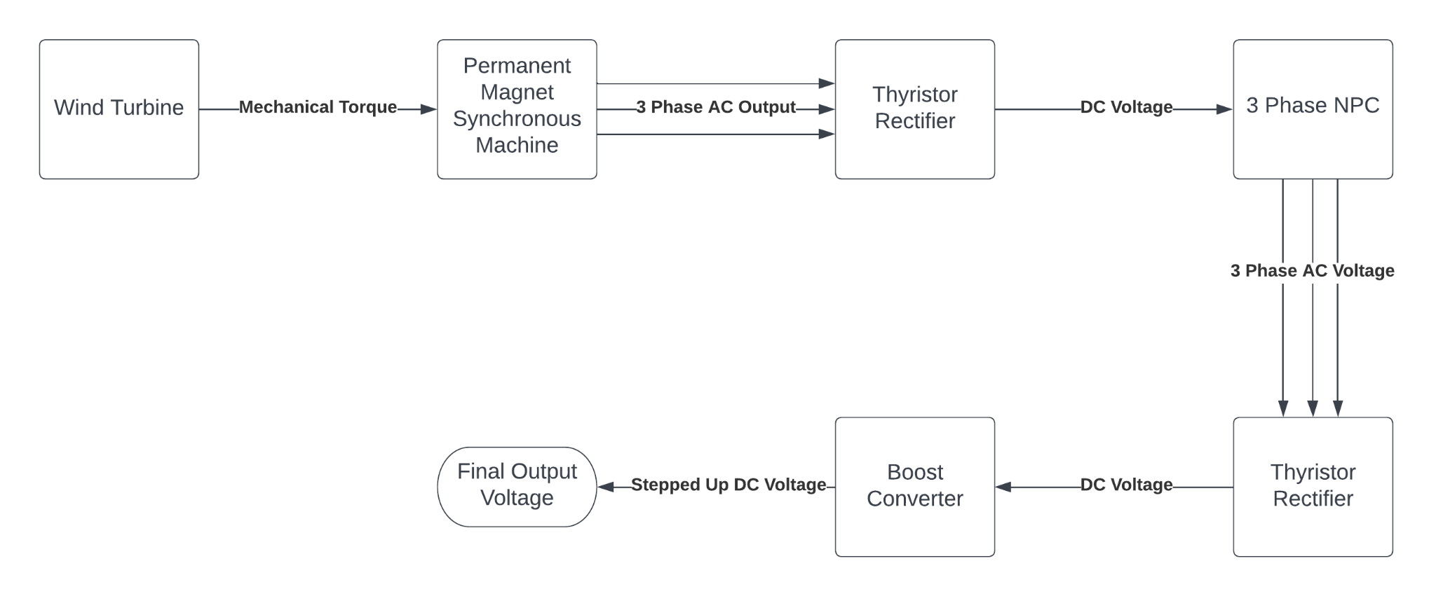
Block Diagram of NPC

Slide 12
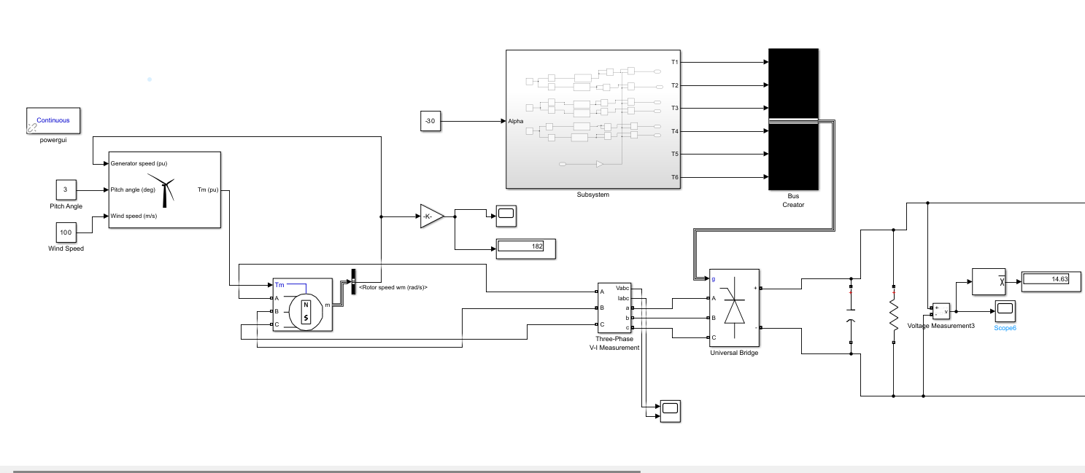
Simulated Circuit - NPC
Wind turbine system and 3 phase thyristor rectifier

Slide 13
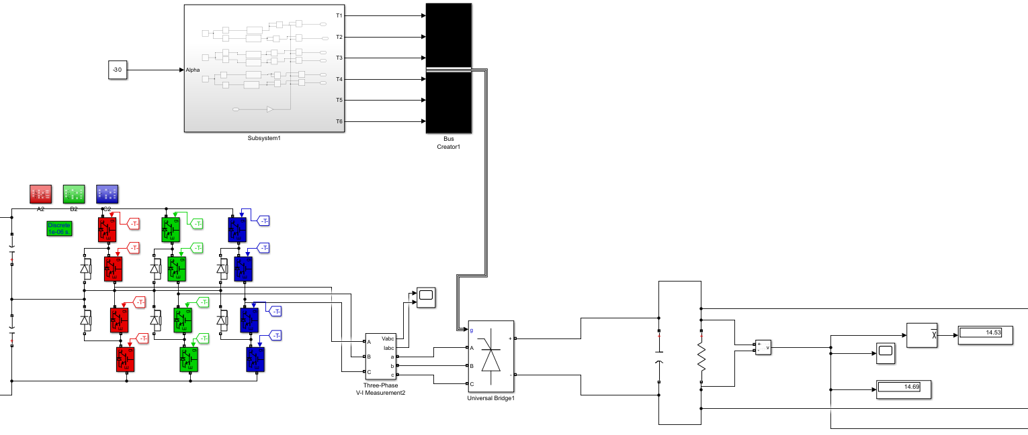
Simulated Circuit - NPC
3 Phase NPC and 3 Phase Thyristor Rectifier

Slide 14
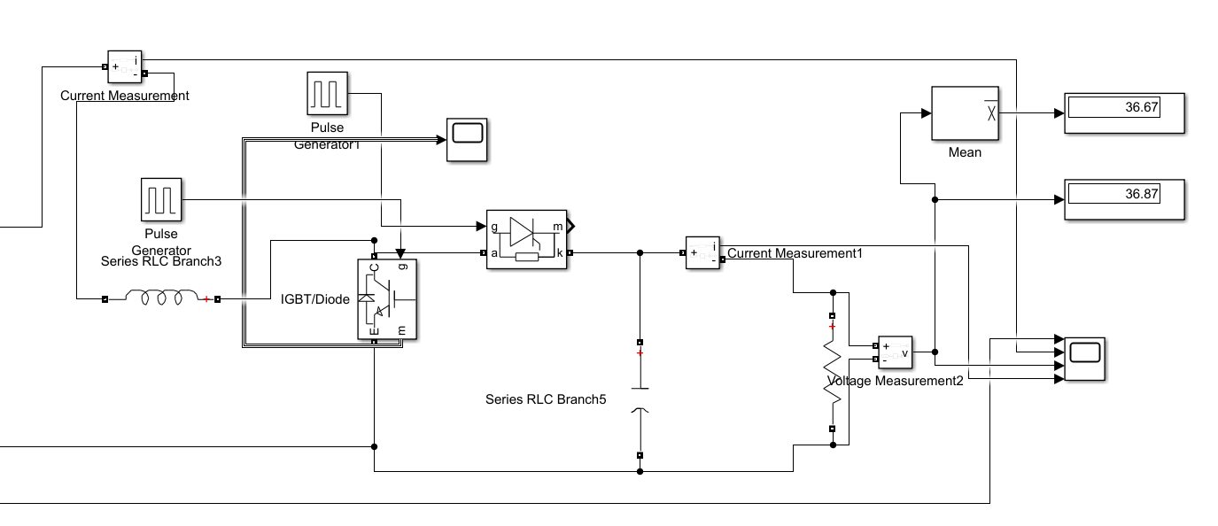
Simulated Circuit - NPC
Boost
Converter

Slide 15
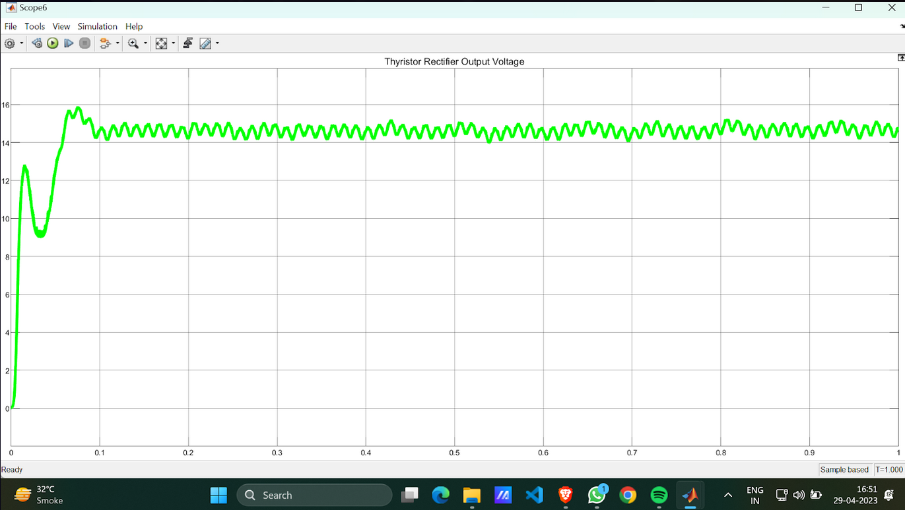
Results - NPC
This figure shows the output obtained from the fully controlled rectifier circuit. It is the input voltage to the NPC in the circuit.It is DC voltage with a mean value of 14.63V.
However due to the presence of AC ripples , we aren't getting a constant DC voltage.To reduce the ripple voltage, a filter is typically used at the output of the rectifier.However, even with a filter, some ripple voltage may still be present in the output.

Slide 16
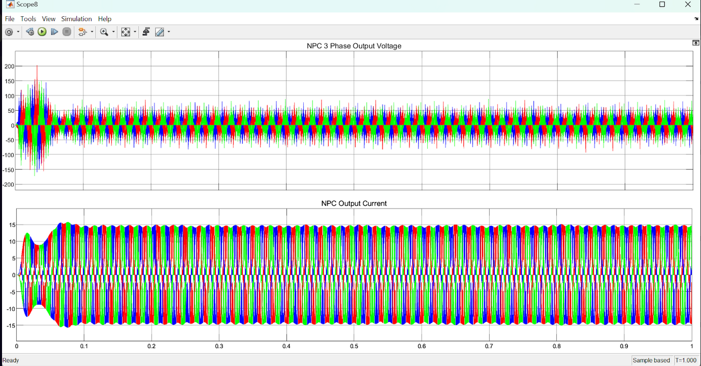
Results - NPC
The NPC system converts the DC voltage from the rectifier to a three-phase AC voltage output which is shown in the figure (all three phases are seen in the figure - red, green and blue)

Slide 17
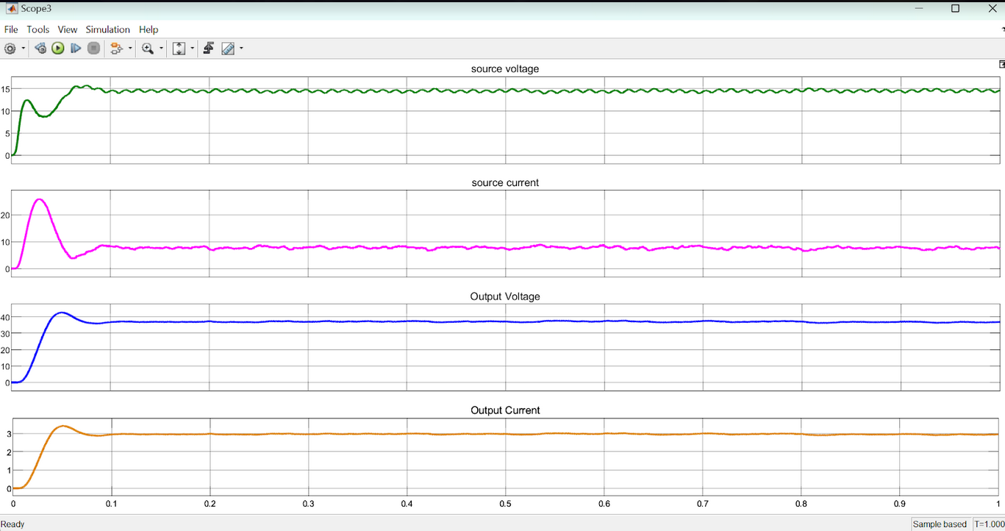
Results - NPC
The results can be observed in the figure.
The first two graphs (green and pink) show the source voltage and source current obtained from the boost converter
The blue and orange graphs show the voltage and current waveforms after ripple cleaning.
The output DC voltage has a mean value of 36.87V

Slide 18
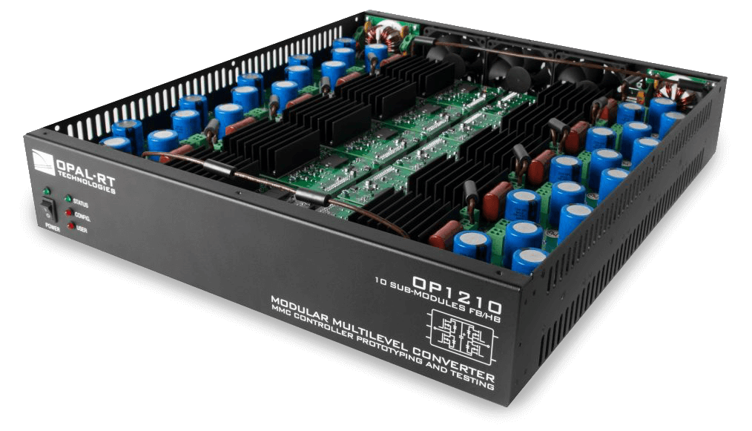
Methodology - MMC
A MMC consists of multiple identical voltage-source converter (VSC) submodules connected in series. Each submodule contains power electronic switches and capacitors arranged in a specific configuration to create a staircase voltage waveform.
The levels of a converter are defined by the number of voltage values each phase (greater than three levels) can generate between the terminal output node and any internal reference node (dc-link node by principle).
Various converter topologies exist, and the current industry has a dynamic interest in increasing these converters' efficiency and usage convenience. Multilevel Modular Converters (MMC) are currently state-of-the-art and industry relevant due to the ability of bidirectional power conversion. The term ‘modular’ is attributed to the physical substructures.

Slide 19
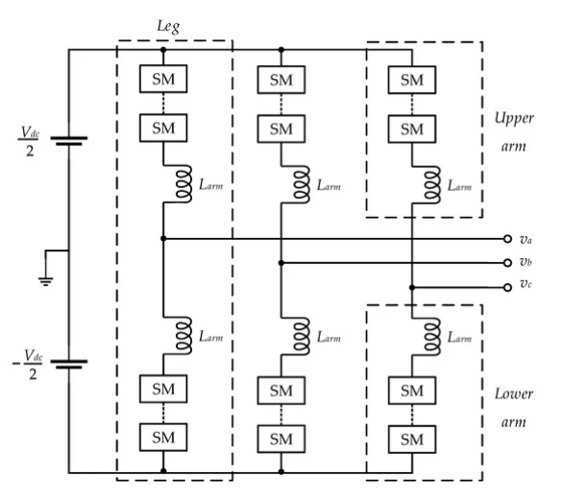
Working of an MMC
The general configuration of a 3-phase MMC comprises a DC terminal, AC terminal, and a control kernel, including legs with symmetric upper and lower arms. The fig shows the structure. It can be seen that the arms have identical submodular structures. The inductors seen are called choke inductors which help suppress high-frequency current components.
The submodule operates as a voltage source. Its output voltage is controlled by adjusting the duty cycle of the switches in each submodule. Each submodule can be independently controlled and replaced, allowing for easy maintenance and repair. The number of submodules can be increased or decreased to match the voltage and power level needed.
A staircase waveform is created by cascading the submodules in series, which is then filtered to create a nearly sinusoidal output waveform. The output voltage can be adjusted by changing the duty cycle of the switches in each submodule.

Slide 20
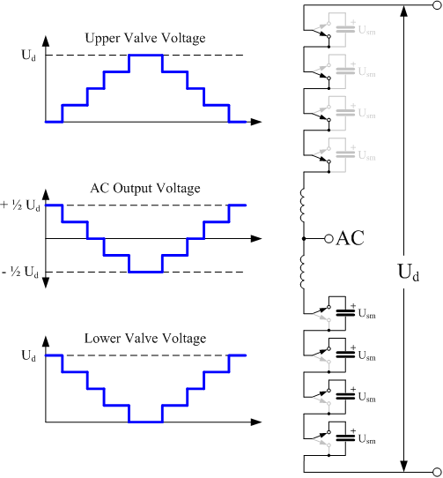
Working of an MMC

Slide 21
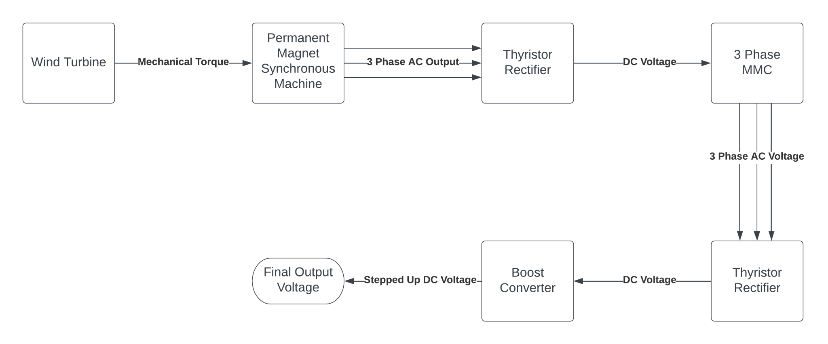
Block diagram of MMC

Slide 22
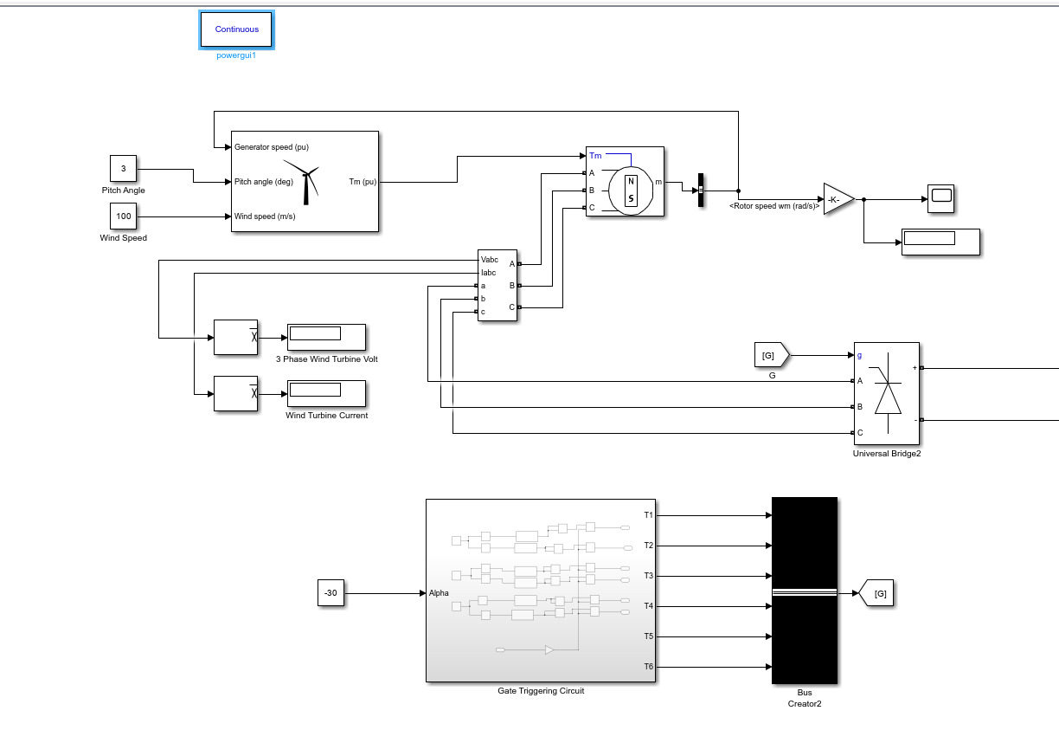
Simulated Circuit - MMC
Wind turbine system and thyristor rectifier

Slide 23
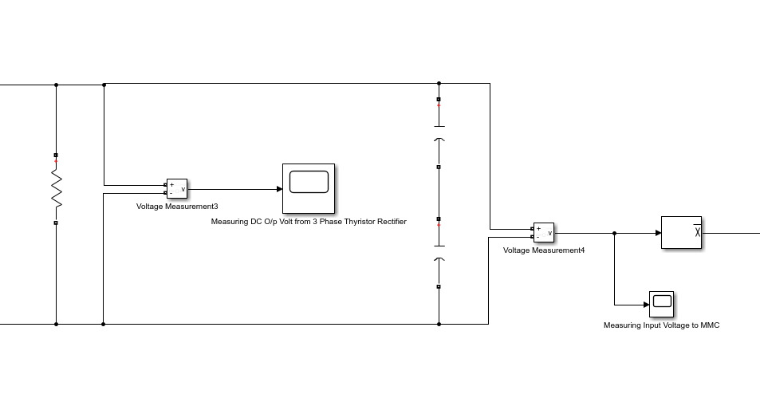
Simulated Circuit - MMC
Output Of
Thyristor
Rectifier

Slide 24
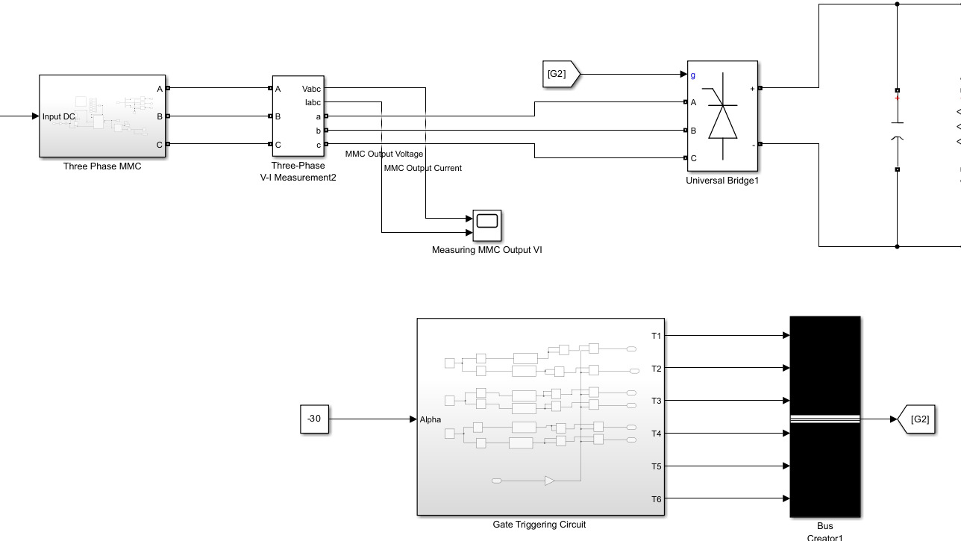
Simulated Circuit - MMC
3 Phase MMC and Thyristor Rectifier

Slide 25
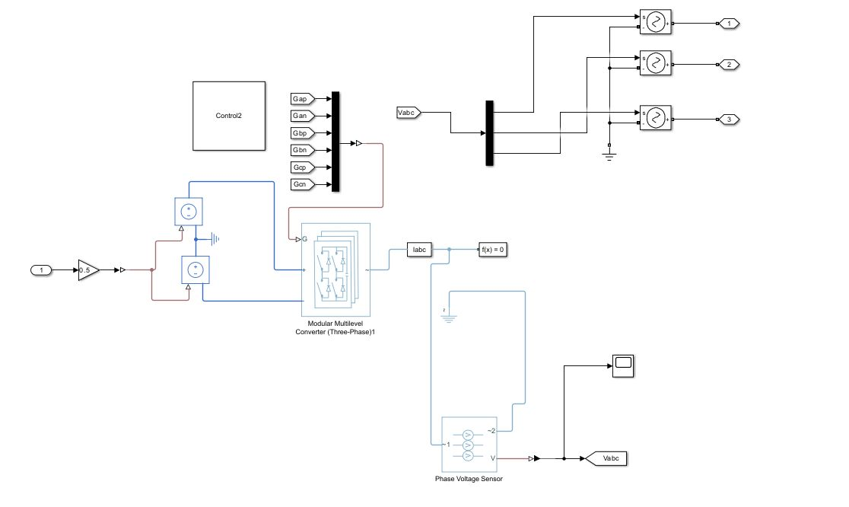
Simulated Circuit - MMC
3 Phase MMC
Implementation

Slide 26
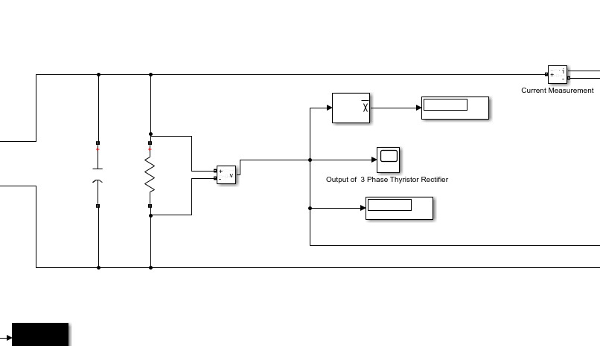
Simulated Circuit - MMC
Output of Thyristor Rectifier

Slide 27
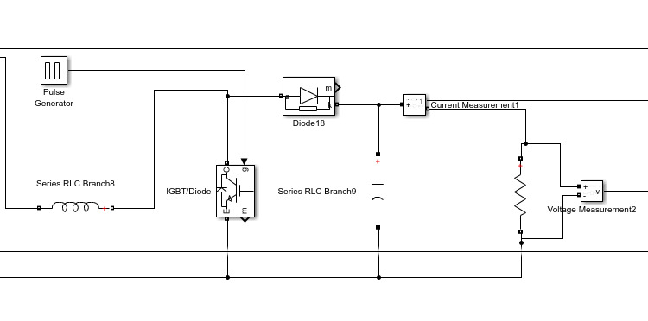
Simulated Circuit - MMC
Boost
Converter

Slide 28
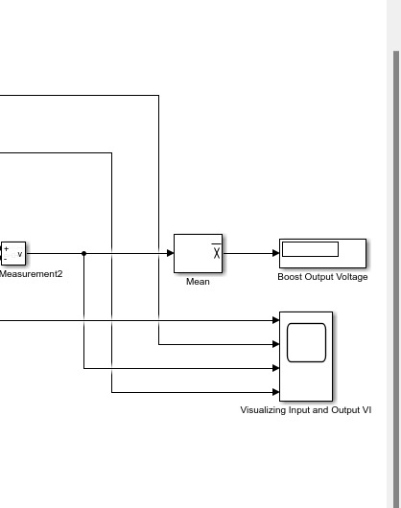
Simulated Circuit - MMC
Measuring output of boost

Slide 29
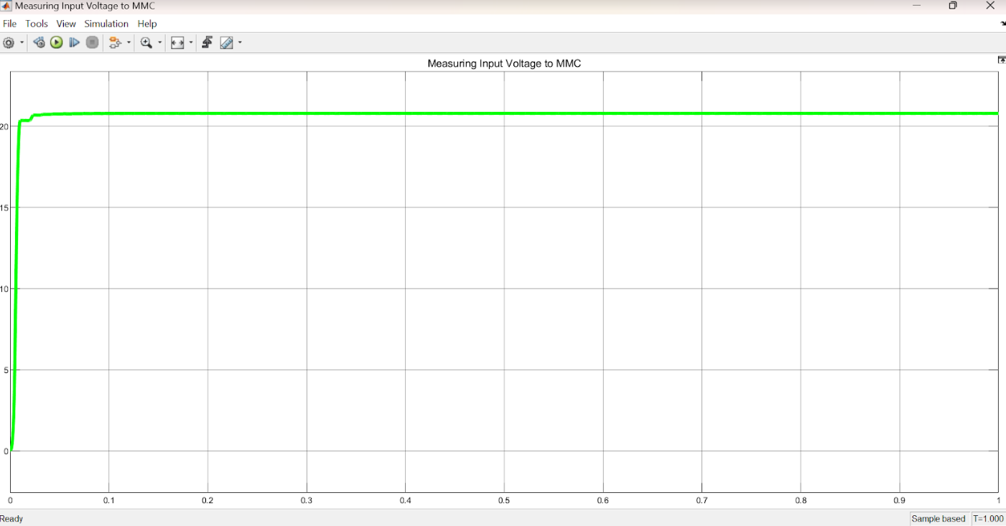
Results - MMC
This figure shows the input voltage to the MMC in the circuit. It is the output obtained from the fully controlled rectifier circuit.
Thus, it is DC-natured with a mean value of 23.9 V

Slide 30
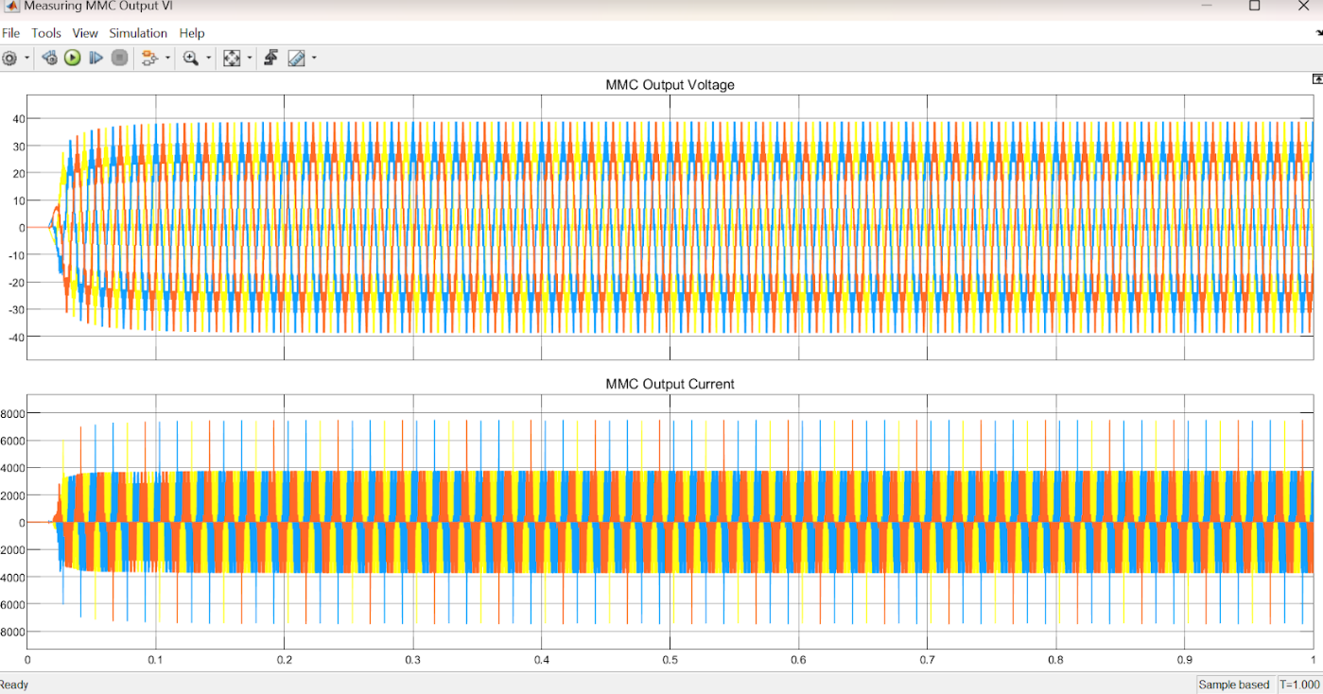
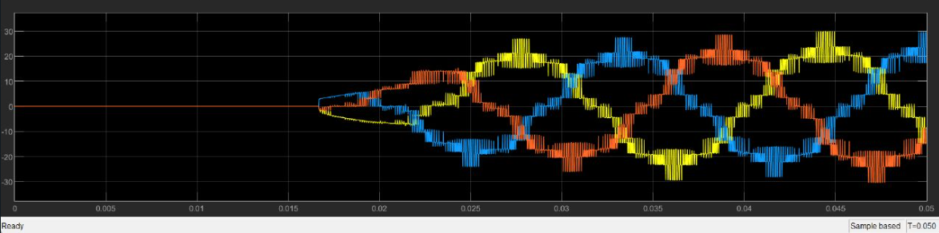
Results - MMC
The MMC system converts the DC voltage from the rectifier to a three-phase AC voltage output which is shown in the figure. The phases differ by 120 degrees. (all three phases are seen in the figure - red, yellow and blue)

Slide 31
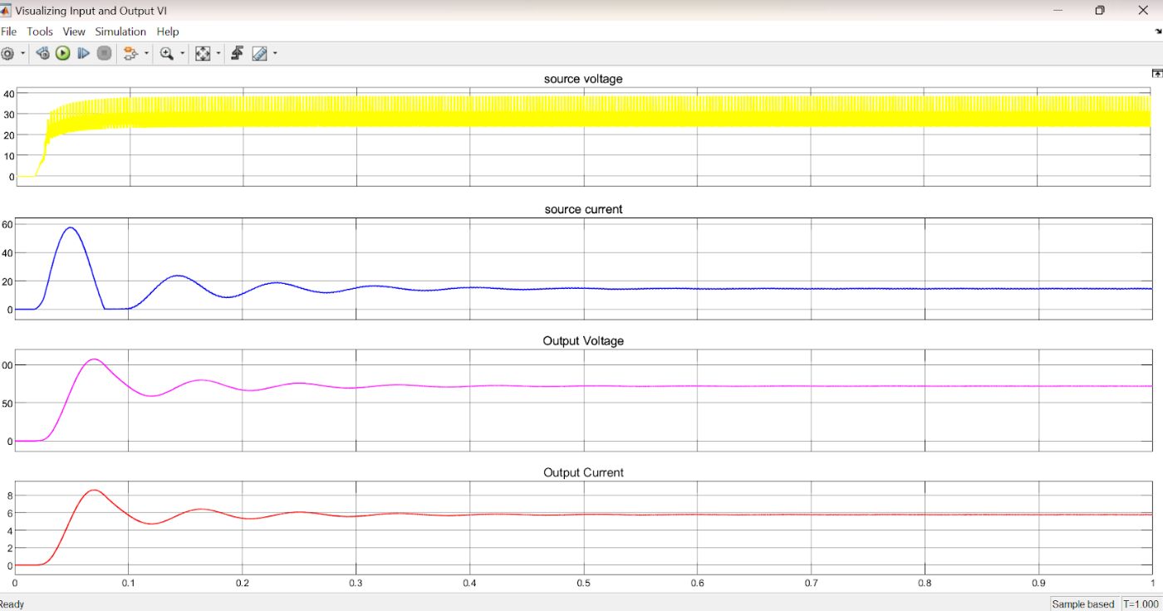
Results - MMC
The results can be observed in the figure.
The first two graphs (yellow and blue) show the source voltage and source current obtained from the boost converter
The pink and red graphs show the voltage and current waveforms after ripple cleaning.
The output DC voltage has a mean value of 71.96V

Slide 32
Conclusion
This paper has presented the improvement of wind turbine system using NPC and MMC converters. From the results obtained in the results section, it can be concluded that the application of these advanced converters has demonstrated significant enhancements in the performance of wind turbines, including :
Higher magnitude of the output voltage for HVDC inputs
Overall higher efficiency
The use of NPC and MMC converters can effectively reduce the impact of variable wind conditions on power generation, and enable wind turbines to operate under a wider range of wind speeds. Overall, the results of this study suggest that the use of NPC and MMC converters holds great promise for improving the efficiency and reliability of wind turbines, and has the potential to contribute significantly to the global transition towards sustainable energy sources

Slide 33
References
F. Blaabjerg and K. Ma, "Wind Energy Systems," in Proceedings of the IEEE, vol. 105, no. 11, pp. 2116-2131, Nov. 2017, doi: 10.1109/JPROC.2017.2695485.
Multilevel Converter (Rodrı´guez et al. Multilevel Converters: An Enabling Technology for High-Power Applications 2016)
Three-phase MMC configuration (Wang, Y Modular Multilevel Converters. Encyclopedia. Available online: https://encyclopedia.pub/entry/5863)

